Slide 1
New Forecast Presentation Structure
July 2023

Slide 2
Incoming data

Slide 3
 | 2020 q2 | q3 | q4 | 2021q1 | q2 | q3 | q4 | 2022 q1 | q2 | q3 | q4 | 2023q1
GDP Growth
CPI
Deficit
Exchange rate
Interest rate
Oil price, etc..

Slide 4
 | 2020 q2 | q3 | q4 | 2021q1 | q2 | q3 | q4 | 2022 q1 | q2 | q3 | q4 | 2023q1
GDP Growth
CPI
Deficit
Exchange rate
Interest rate

Slide 5
Comparison to forecast
Forecast Vs Outcomes and story

Slide 6
Current stance

Slide 7
Description of cyclical position
Demand overheated or subdued
Exchange rate overvalued or undervalued
Monetary policy loose or tight
Inflation is above or below the target (reason: either demand or supply shocks)
Expansionary or contractionary fiscal policy

Slide 8
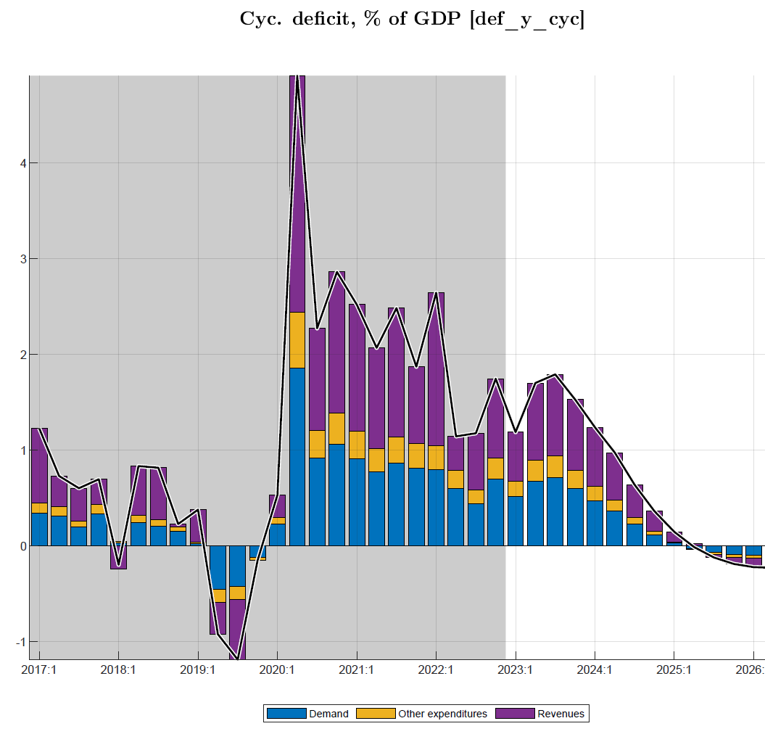
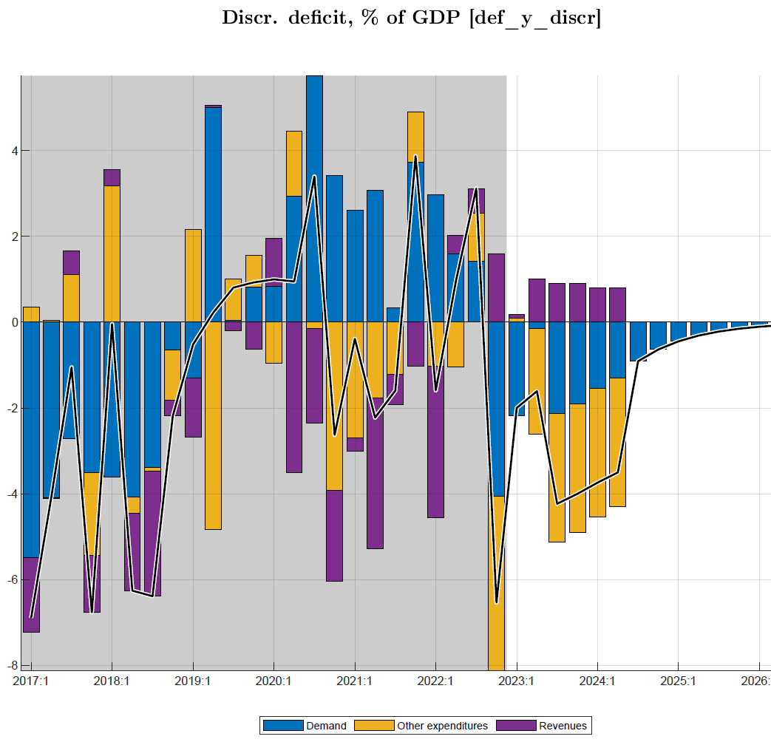
Fiscal policies: deficit and its components (discretionary, cyclical, structural) only history
Deficit discretionary & cyclical components forecast (w. near-term program), phasing out gradually
discretionary (demand, other) spending reductions
losses in (non-tax), revenue, gradually offset
Cyclical deficit components phase out as output gap to zero
Notes:
Optional illustration of fiscal impulse in relation to output/gap

Slide 9
Forecast assumptions

Slide 10
External environment/variables
US interest rates
Oil price

Slide 11
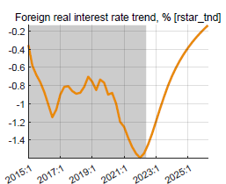
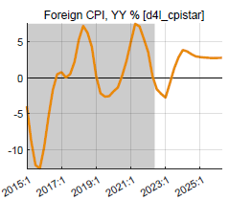
External environment
World economy slowing down as interest rates are raised in response to inflation
Rwanda still enjoys recovery in trading partner demand relative to Covid-years, at 3% p.y., well above trend
World real interest rates are projected to increase from negative in the past decade to close to zero in the near term.
Trading partners’ CPI (in US$) was subdued at 1.5% py in past 5-7 years
Projected to return to more normal level of 3% in coming years

Slide 12
Fiscal assumptions(NTF, Medium, and long-term)
reduction fiscal deficit (before grants) to 12.1% of GDP in 2022/23 (tuned), then to 11% of GDP (sustainable)
favorable fiscal impulse—over 2% of GDP on average in 2020-2022—is ending
Fiscal consolidation with the 2022/23 Budget with phasing out of Covid and Ukraine-crisis-related spending, and reduction in fiscal deficit and fiscal impulse

Slide 13
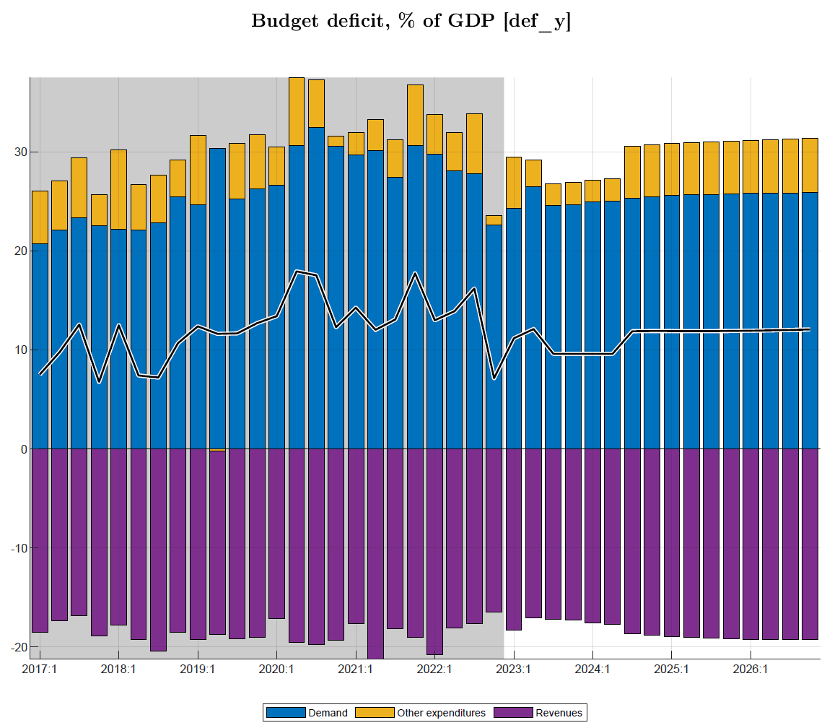
Fiscal policies: deficit and its components (revenue, spending)
Deficit (excl. grants) forecast to tighten +2% points of GDP below pre-Covid and sustainable level from 2022/23, as program fast-tracks debt/GDP reduction, then return to sustainable level by 2030
Deficit (components) tuned with near-term program
large spending cuts compared to Covid and even pre-Covid for four years from 2023/24
also, to offset temporary revenue shortfalls of around 1% of GDP levels in 2023/24-2024/25
deficits dips well below sustainable level for several years, thus helping reduce debt/GDP accumulated during Covid (esp. IMF)
sustainable deficit: from grants (+4.5% of GDP) and net borrowing consistent with debt/GDP of 75% (65% in NPV, 10% domestic, 15% grant element, …)
Notes:
Optional illustration of fiscal impulse in relation to output/gap

Slide 14
Domestic assumptions
Fiscal policy ( near term, medium and long-term)
Trends
GDP components
Exchange rates target
Real interest rate ( incl. premium)
Inflation target
Current fiscal, monetary, and exchange rate policies:
Maintenance of current level of policy interest rate (interbank rate)
Somewhat faster exchange rate depreciation in 2023 (than 2022), targeted in PCI
Expected return to normal of agricultural harvests and domestic food prices

Slide 15
Near term assumptions
GDP Nowcast
Inflation NTF
Interest rates and exchange rate NTF
maintenance of recently increased policy interest rate (tuned for 2023Q1)
somewhat faster rate of exchange rate depreciation in 2023 (tuned for 2023Q1)
Fiscal NTF

Slide 16
Forecast story

Slide 17
Forecast—private consumption
Consumption gap:
key driver of 2020-21 negative output gap (~ 75% of GDP)
Covid negative shocks (persistence) forecast to end in 2023
fiscal impulse helped offset somewhat negative Covid consumption shocks but it is ending in 2023

Slide 18
Fiscal policies: deficit and its components (discretionary, cyclical, structural)
Deficit discretionary & cyclical components forecast (w. near-term program), phasing out gradually
discretionary (demand, other) spending reductions
losses in (non-tax), revenue, gradually offset
Cyclical deficit components phase out as output gap to zero
Notes:
Optional illustration of fiscal impulse in relation to output/gap

Slide 19
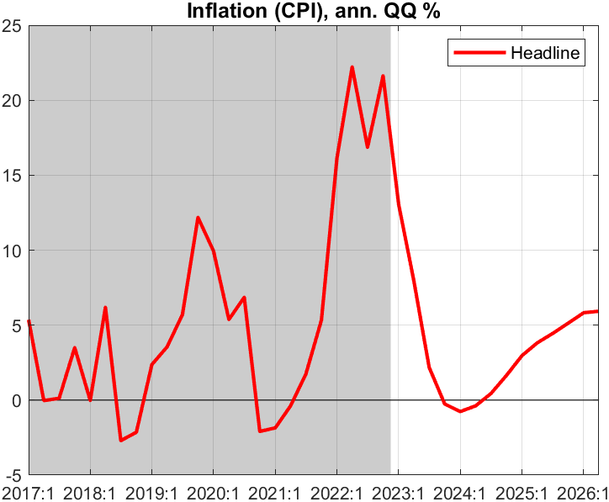
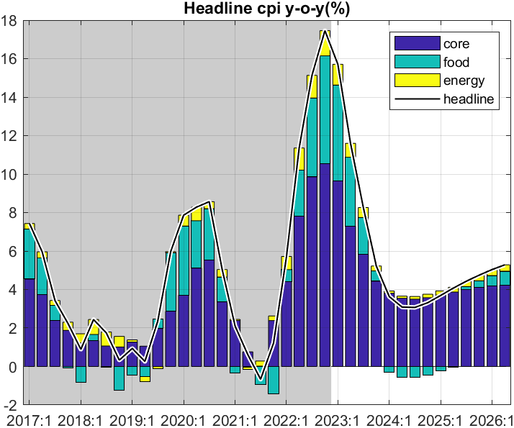
Forecast—Inflation outlook (overview) focus on Q on Q
q-on-q annualized inflation is forecast to decline gradually in 2023 after peak in Q2 2022
predicated on recent shocks abating and inflation expectations being countered by NBR action and fiscal restraint
Headline CPI components
decline in q-on-q inflation translates into a lesser drop in y-on-y inflation estimated to peak in Q4 2022,
Y-on-y inflation dropping to target of 5% in end of 2023(2023Q4)
all components drop, drop in food prices contributes most
Notes:
Table as % change, chart has d4log

Slide 20
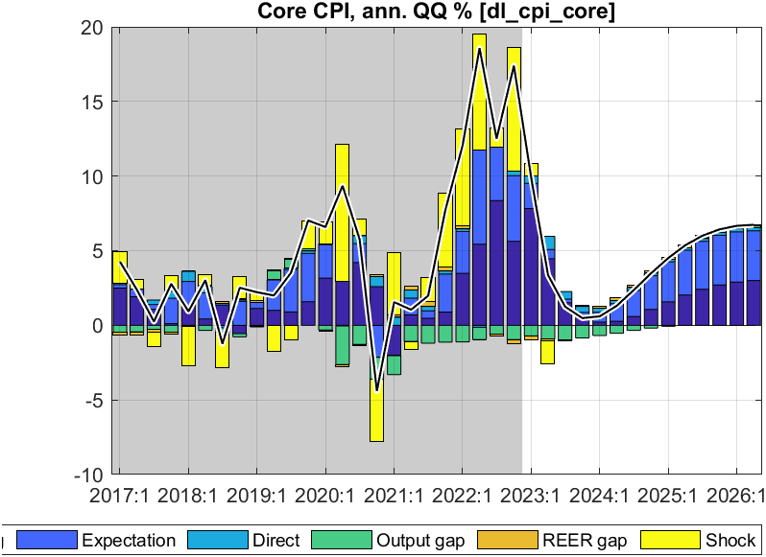
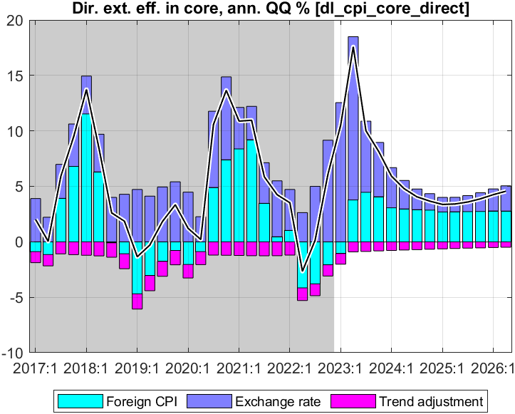
Forecast—Core inflation (q-on-q annualized)
Direct effect foreign import prices and ER on CPI core:
foreign prices continue declining for most of 2023-26
ER depreciation raises RWF prices, but net direct effect is small
CPI core from peak 2022 Q4; main drivers:
down-pull effect from remaining output gap disappearing
strong effect of expectations and persistence
no direct effect of import prices as constant in RWF terms

Slide 21
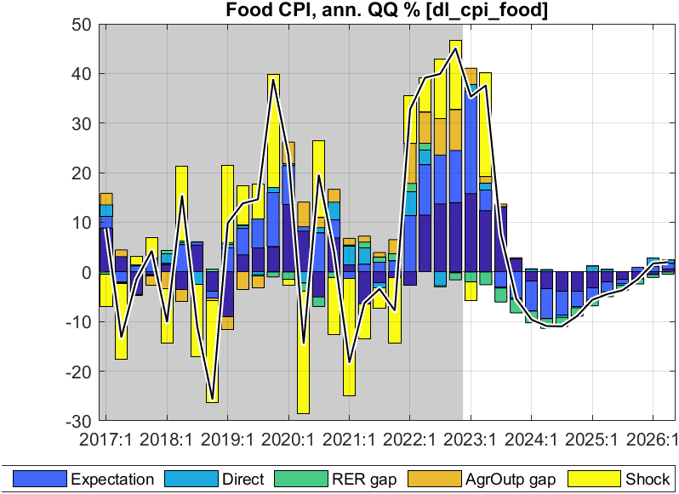
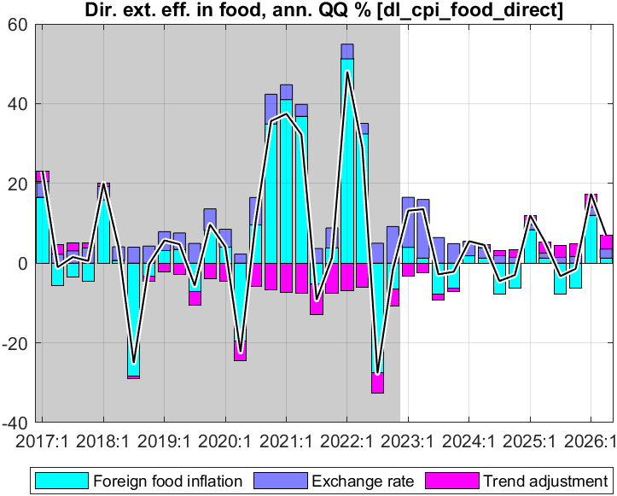
Forecast—Food inflation (q-on-q annualized)
Direct effect of foreign prices and ER on food CPI
foreign food prices continue declining for most of 2023-26
ER depreciation raises RWF prices but net direct effect is small
CPI food decreasing from peak in 2022 Q4; main drivers:
agricultural output is forecast to normalize
imported food prices projected to continue declining
small offsetting effect of lessening RER overvaluation (faster depr.)

Slide 22
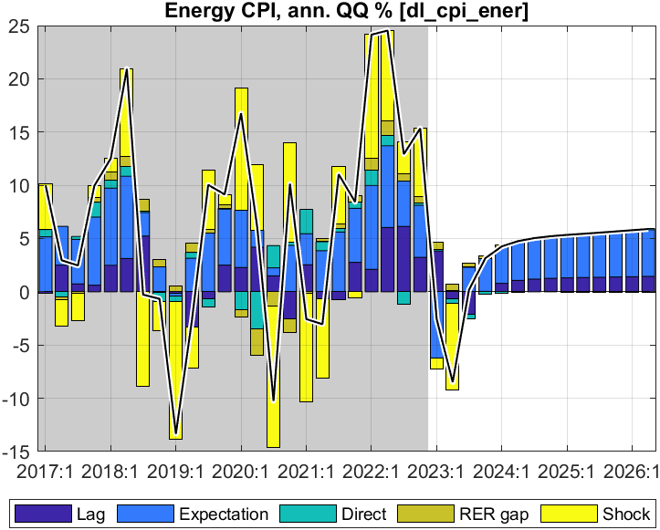
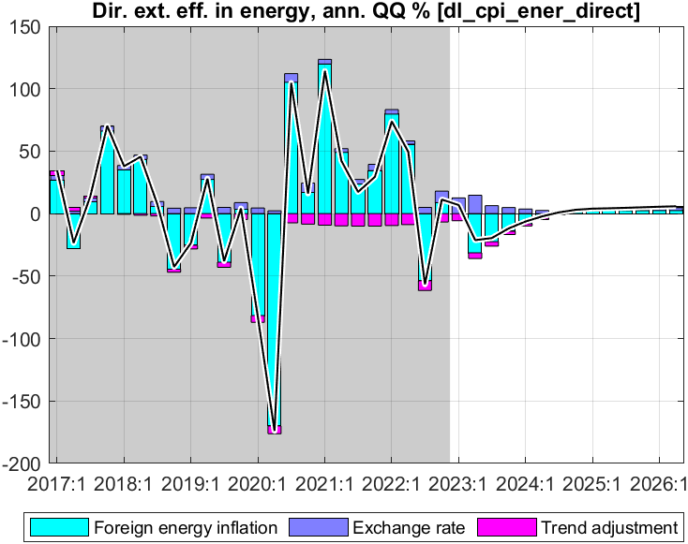
Forecast—Energy inflation (q-on-q annualized)
Direct effect foreign import prices and ER on energy CPI:
foreign energy prices continue declining for most of 2023-26
ER depreciation raises RWF prices, but net direct effect is small
CPI energy decreasing from peak in 2022 Q4; main drivers:
imported energy prices projected to continue declining
small offsetting effect of lessening RER overvaluation (faster depr.)

Slide 23
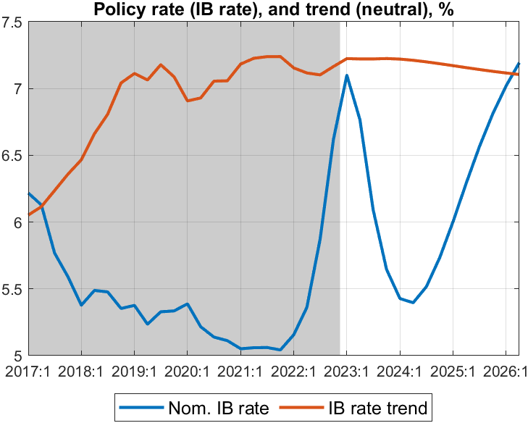
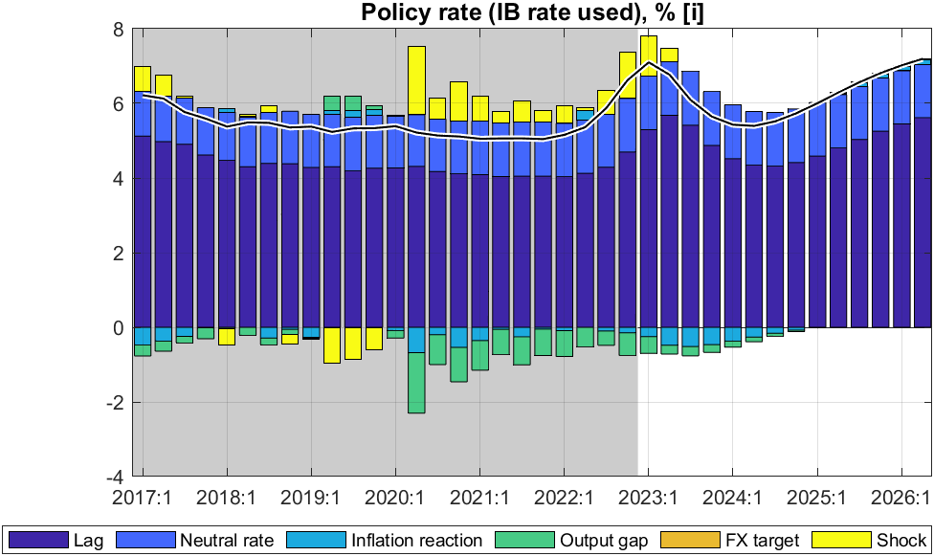
Forecast—Policy interest rate (interbank rate, IB)
Policy rate (IB) driven by rule:
responding to both inflation deviation (from 5% target) and the output gap
gradual interest rate changes (lagged effect)
pulled to ‘neutral’ rate of 7% (foreign real rate, country risk, core inflation)
somewhat historical policy rate shocks since 2022-23—fading in forecast
Policy rate (IB) influenced by NBR with its CBR:
IB followed closely the 2% points CBR increases in 2022
IB forecast a little tight (aver 6.6 %) in 2023 to control inflation, then to decrease (loose) to ~5 % to improve demand (still gap) in 2024
from 2024, increase back to trend driven by a ‘neutral’ rate of ~7%
increased policy rate should raise RIR and stem demand

Slide 24
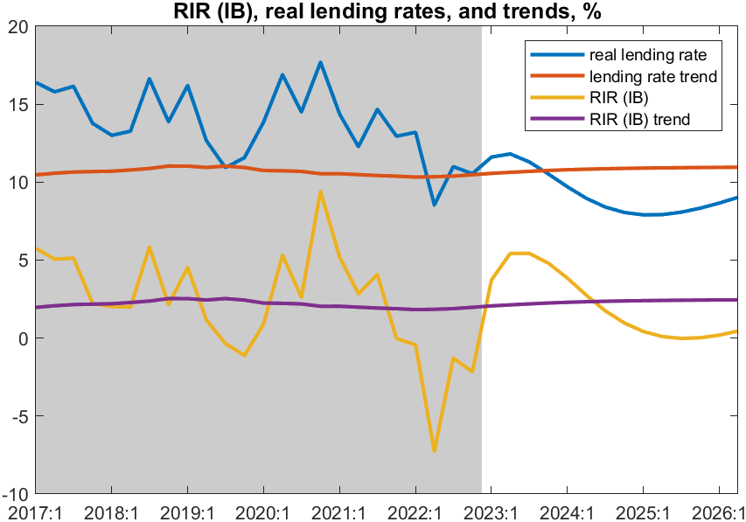
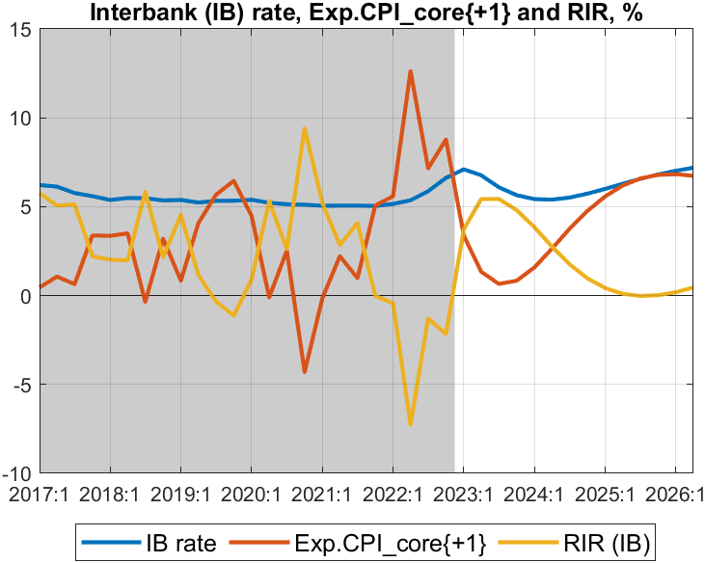
Forecast—Real interest rate (RIR) (policy and lending rates)
RIR policy rate (IB) components:
After a tight RIR (IB) due to ease in expected inflation and constant in late 2022-23 and RIR is loose post-2024 following as IB rate stabilizes and inflation surges again.
RIR policy rate (IB) (~ core-inflation one Q ahead)
RIR is tight-- continue rising and turn positive by mid-2023-end 2024
thus, correcting sharply below-trend levels since late 2021
post-2024 –RIR gets loose again, returns toward trend and ‘neutral’ rate of 2.5%.
real lending rate (including ~ 8% premium) also back to trend. ending the pull-up effect on private demand

Slide 25
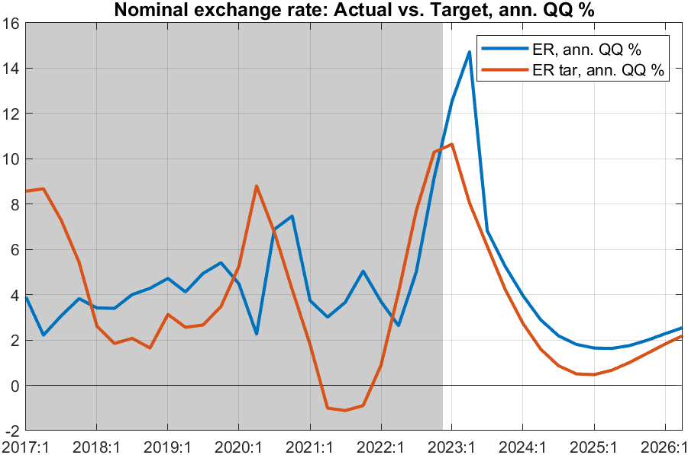
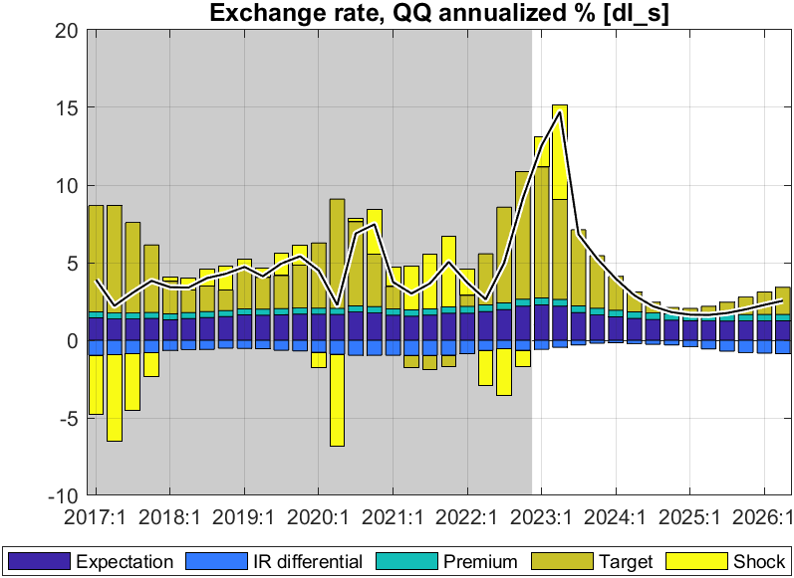
Forecast—Nominal exchange rate (ER)
Exchange rate policy “rule”
mainly driven by nominal ER target, expectations, and somewhat by domestic-foreign interest rate differentials.
ER target driven by trend RER depr. rate (0%) and inflation differential (2%)
ER policy reflected in forecast:
reflects NBR’s flexible ER policy, and hybrid rule:
ER steered toward target ER so that RER gradually falls in line with its target or trend depreciation rate
some response to domestic-foreign interest differentials
A temporal overvaluation in 2023, before ER steered back to target
trend depreciation rate converges to 3% p.y.

Slide 26
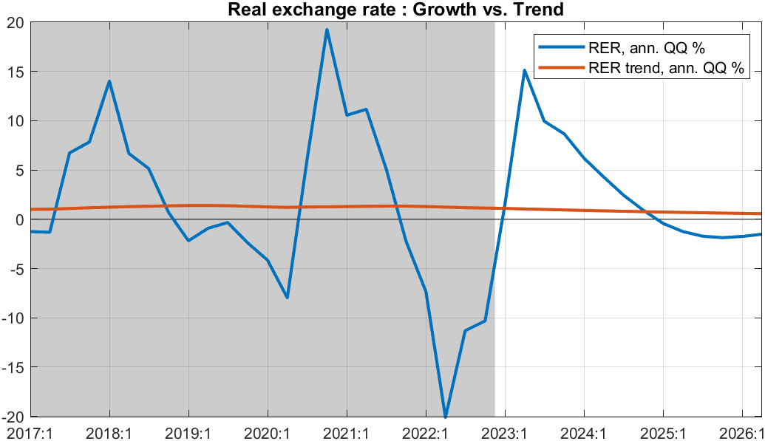
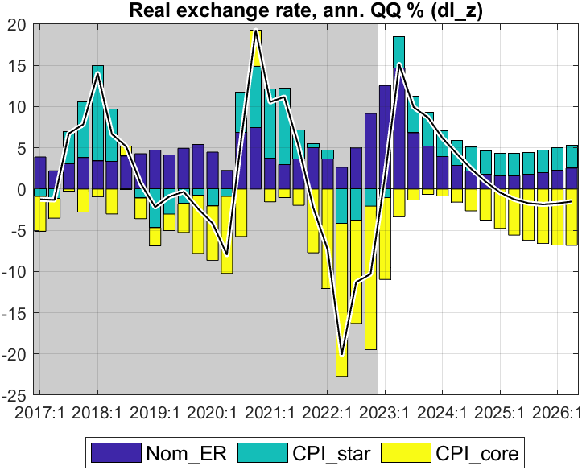
Forecast—Real exchange rate (RER, q-on-q change annualized)
RER components
after sharp decline in RER since Q3 2021 as core inflation surged,
RER is forecast to increase from Q2 2023 on for several quarters
before returning to its trend (0%)
RER results from ER, CPI_core and foreign CPI
forecast to switch from real appreciation in 2022 and early 2023 to real depreciation from mid-2023
returning toward trend RER depreciation rate (0%) thereafter
pull-down effect on demand from RER appreciation in most of 2022 should reverse from 2023 onward as RER returns to trend

Slide 27
Forecast summary

Slide 28
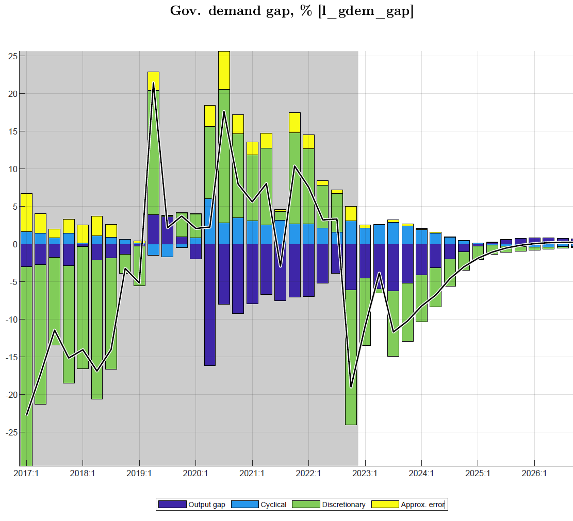
Forecast: govt demand for G&S effects
Fiscal policies (“fiscal stance”) affect output in the short-run via several channels captured in the model:
govt demand for G&S affects final demand and output directly
discretionary deficit plus change in structural deficit (defined as “fiscal impulse”) affect private demand and output indirectly
cyclical deficit—automatic higher spending and lower revenue in downturn (and vice versa)—affects output
Government demand for G&S (≈23% of GDP):
mainly exogenous (discretionary spending)
some anti-cyclical spending (e.g. transfers) kicks in under downturn, esp. in Covid episode
under Covid, high govt demand offset negative output gap, with positive impact estimated at 1½ % of GDP
from 2022/23, sharp tightening in govt demand with reverse, i.e. negative impact on output gap
Notes:
See Output gap and Fiscal Impulse in last Chart

Slide 29
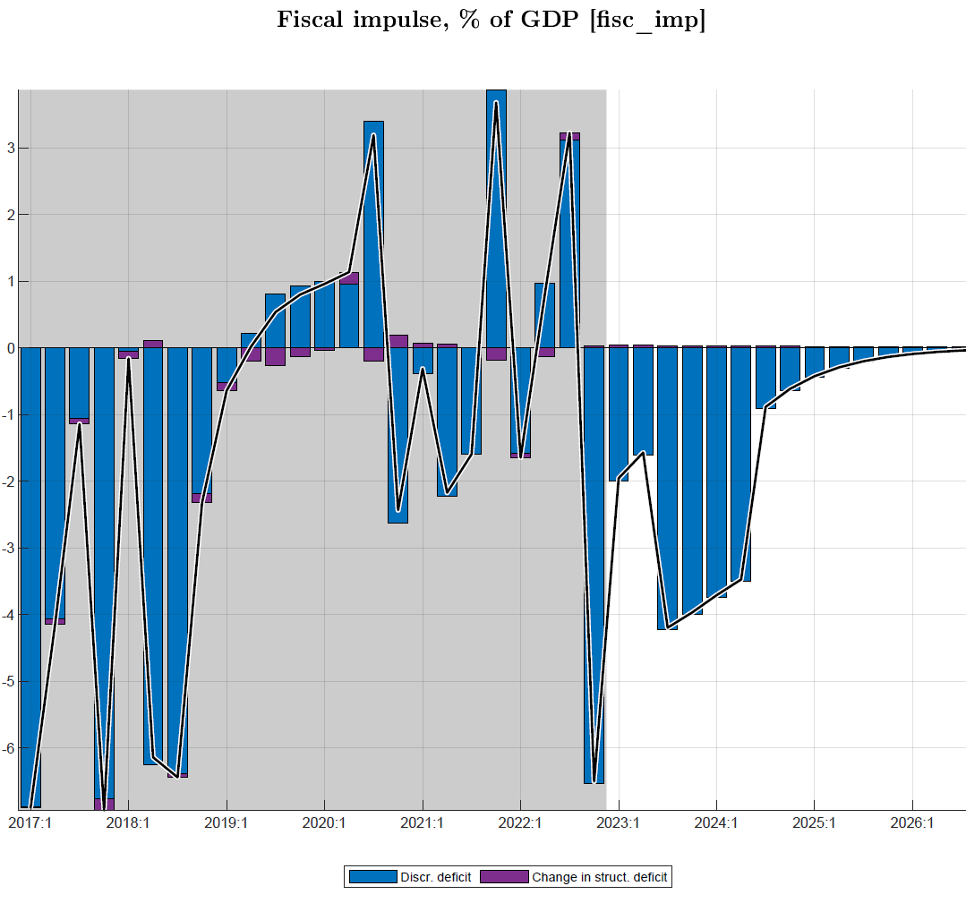
Fiscal policies (ii): fiscal impulse on private dd
Fiscal impulse:
had large positive fiscal impulse in only a few quarters during 2020-22, and relatively small on average over the period
affects private consumption and investment via income effect and “confidence factor”
the fiscal impulse effect on private demand and hence output during Covid years is estimated at about ½% of GDP
Add story for forecast:
Notes:
In more aggregate models, “fiscal impulse” comprises both direct effect of govt spending on G&S and the indirect effect via private consumption and investment (affected by transfers/subsidies and reduced effective revenue collection)

Slide 30
Forecast—Output (real GDP) growth
Output growth: to rise a bit above trend in 2023-24, completing post-Covid recovery
Driven by:
consumption recovering from Covid shocks, helped by below-trend RIR
exports recovering from Covid shocks though hampered by still below-trend RER
government spending to soften Covid- and Ukraine-crises impact ends with FY 2022/23 (see Fiscal Impulse below)
return to trend of 7.5% p.y. from 2025

Slide 31
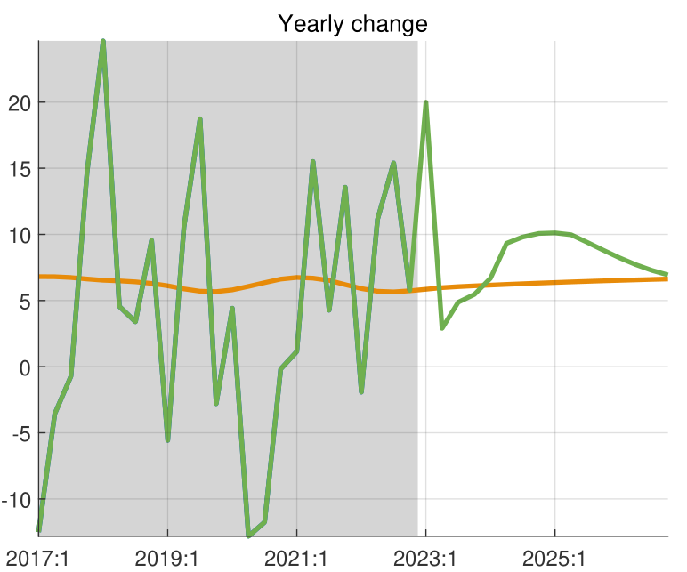
Consumption growth:
continued recovery from Covid, with higher than trend growth in 2023-24
returns to its trend growth from 2025

Slide 32
Forecast—Inflation outlook (overview) table Y on Y
q-on-q annualized inflation is forecast to decline gradually in 2023 after peak in Q2 2022
predicated on recent shocks abating and inflation expectations being countered by NBR action and fiscal restraint
Headline CPI components
decline in q-on-q inflation translates into a lesser drop in y-on-y inflation estimated to peak in Q4 2022,
Y-on-y inflation dropping to target of 5% in end of 2023(2023Q4)
all components drop, drop in food prices contributes most
Notes:
Table as % change, chart has d4log

Slide 34
Duplication of incoming data with forecast period

Slide 35
Forecast of key macro indicators
RIR forecast to rise (albeit from a low negative level) and exert less upward pressure on private demand
RER forecasted to rise from low, negative level and exert less downward pressure on private demand
Headline inflation (estimated peak in Q4 2022) forecast to decline gradually in 2023 as food and energy prices are forecast to continue falling from their peaks in 2d half of 2022; and to be close to 5% target from 2024
GDP growth forecast to pick up to average 8.5% in 2023-24 before returning to its trend of 7.5% annually
Output back to potential as low (albeit rising) RIR, rising (of albeit still low) RER, and modest (albeit declining) fiscal impulse keep demand up

